Slide 1

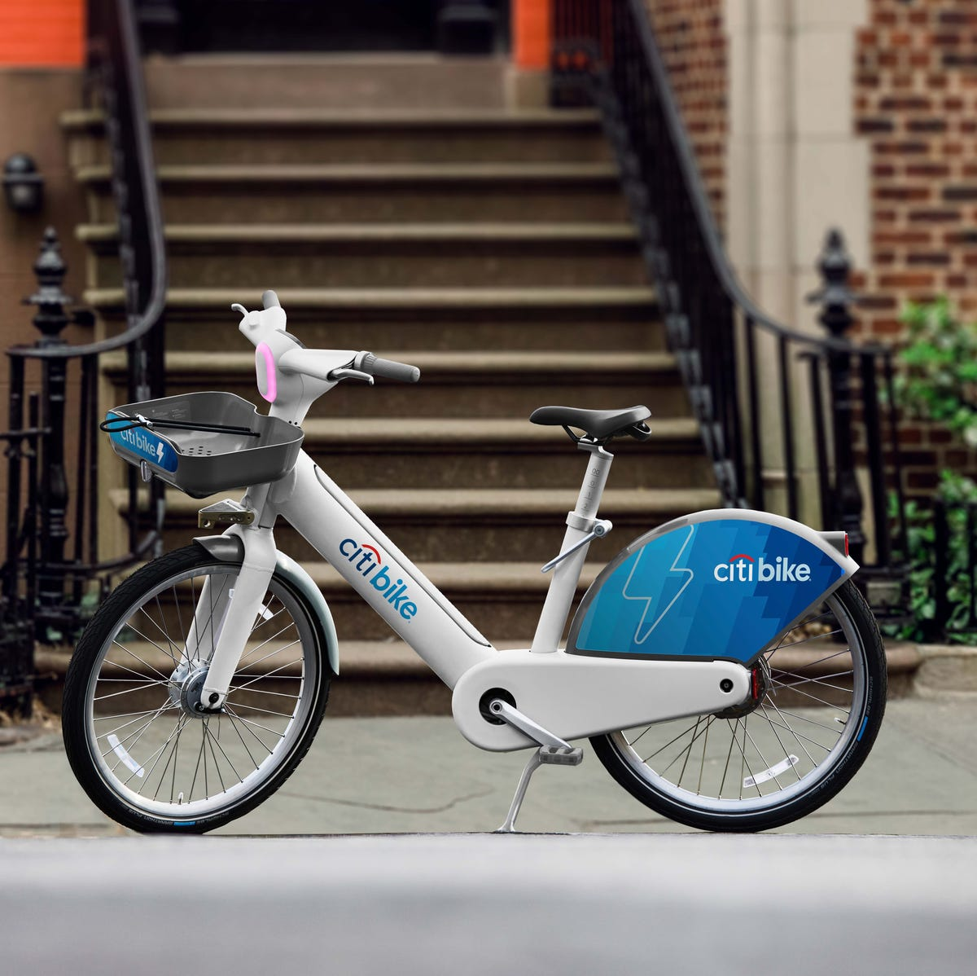

Forecasting analysis of bike rides in Jersey City from the docks JC052 and JC081
CitiBike Jersey Station
MBDS - Forecasting
July 16, 2024
Group 4
ALVARO VERONA CHIRINOS, LAURA LOPES VALE ESTRADA DE BARROS, MARÍA FERNANDA HERNÁNDEZ MONTES, PAULA CACERES CAVERO, RAWAD YARED
Notes:
Imagine this, you woke up got ready for work, and went down to your most reliable bike dock that you take everyday to work and you don’t find any available bike. First day would be okay I guess but then that starts happening almost everyday. Meanwhile a dock only 2.4km away is almost fully stocked and not used during these hours. It’s not only frustrating to the customer, but a loss of revenue and potential future customers for citibike. That is why we chose to analyze 2 stations for citibike and accordingly bring some actionable insights.

Slide 2

Who is Citibike?
Mission: “improve people’s lives with the world’s best transportation”
2015
Launched in JC in September 2015
1000+
employees
$100+
Million
Revenue (Citibike)
Number of operational bikes in JC
600+
Operates in
2
cities
Number of bike stations in JC
60+
Notes:
So who is citibike? Citibike is one of the largest bike sharing companies in the US whose mission is to improve peoples lives with the worlds best transportation.

Slide 3
Who is Citibike?
2015
Launched in JC in September 2015
1000+
employees
$100+
Million
Revenue (Citibike)
Number of operational bikes in JC
600+
Operates in
2
cities
Number of bike stations in JC
60+
Notes:
To give you a better understanding of them, here is a quick summary 1- they launched in 2015 in Jersey City 2- they have more than 1000 employees 3- Generate 100+ million in revenue 4- and operate over 600 bikes in only Jersey city.

Slide 4
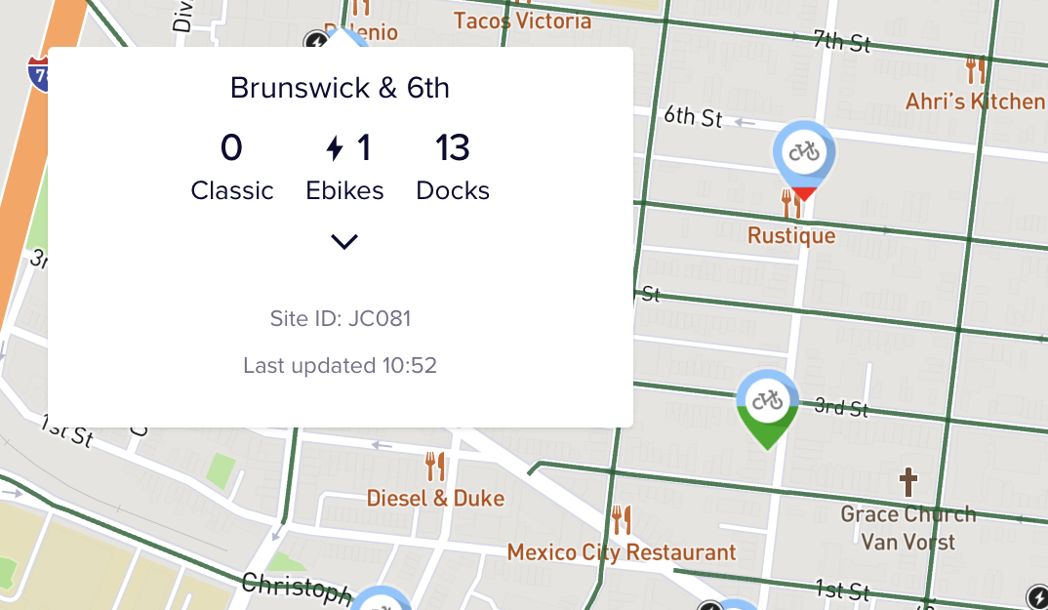
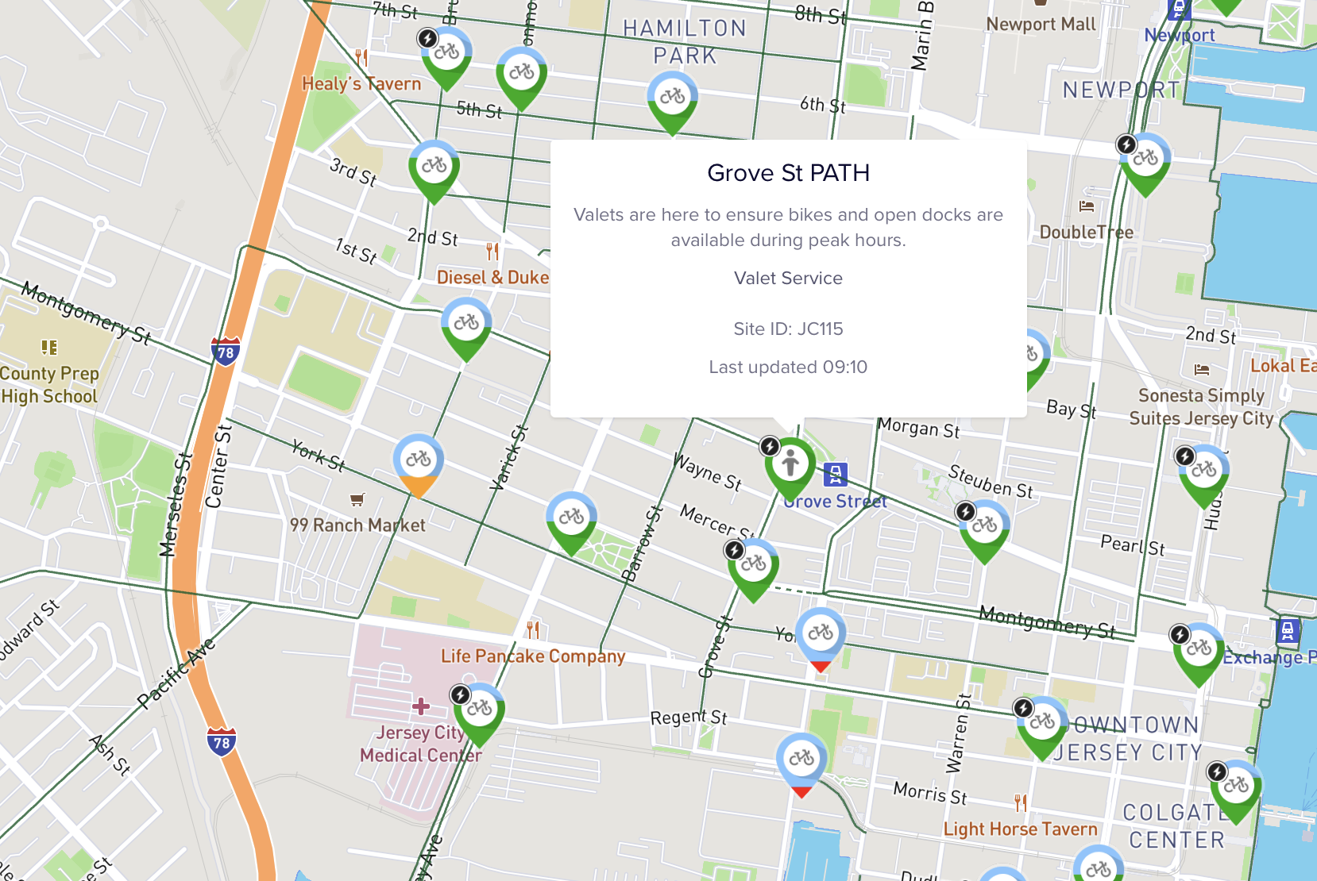
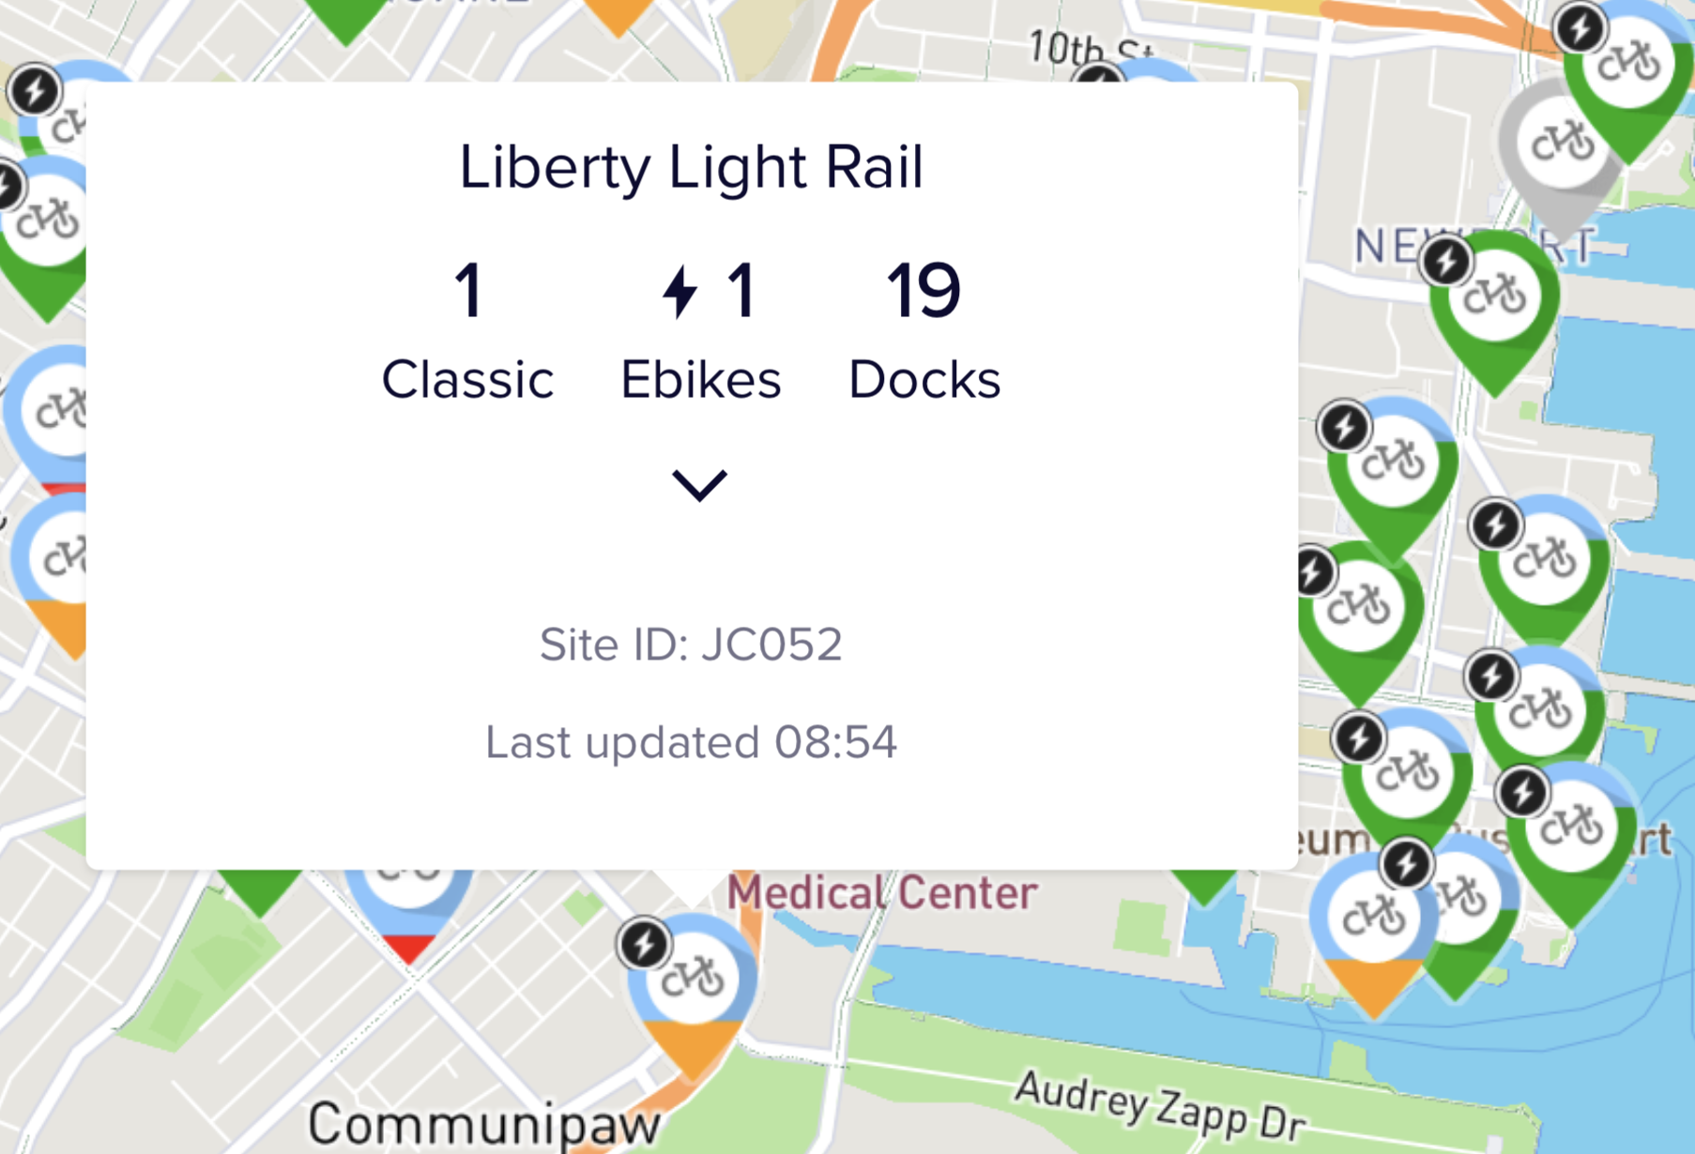
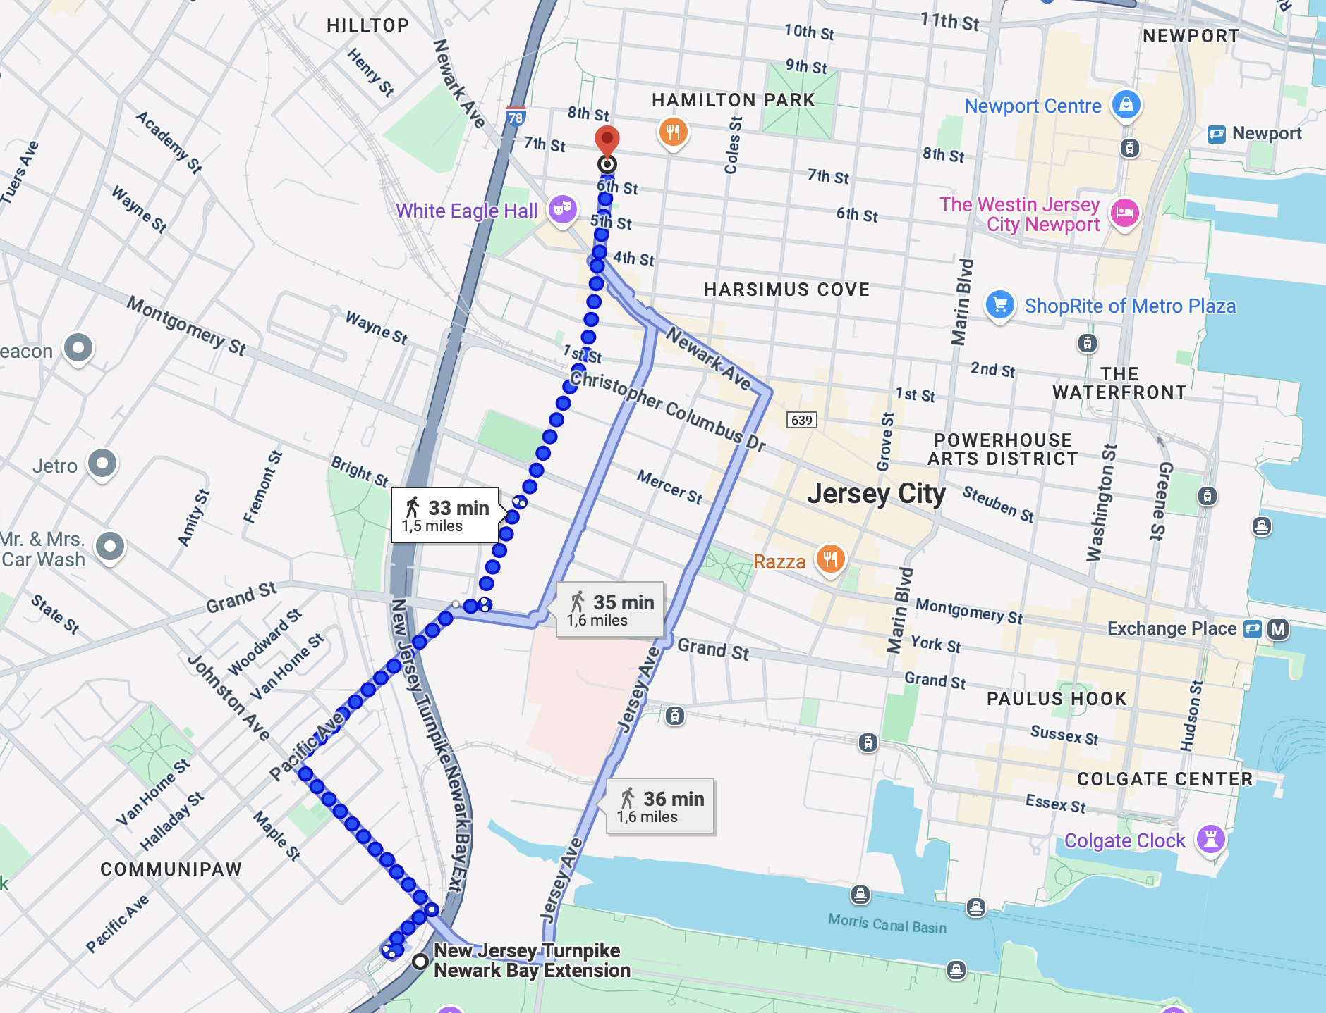
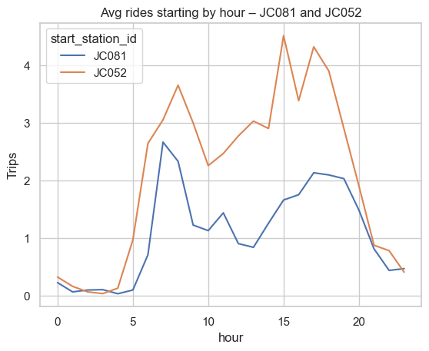
Why the docks of JC081 and JC052?
Key analysis points
1
Docks are only 2.4km away from each other
2
Dock JC052 fits 50% more bikes than JC081
3
Dock JC081 is near a valet serviced dock that leverages other docks
4
Though both docks are close by, they behave differently on an average day
Notes:
For this analysis we chose 2 docks to analyze which were JC081 and JC052 for 4 key reasons:
1- The docks are relatively close being only 2.4 km away from each other 2- the docks were surprisingly very different in size with a 50% difference 3- Dock JC081 is close by to a valet serviced dock which relies on nearby docks 4- Though they are close in region, they behave differently throughout the day

Slide 5
What the dataset included?
Data Set Description
Unique 16 character alphanumeric code
Timestamp of the date and starting time
Station name where the ride started
Station name where the ride ended
The latitude coordinates of the start station
The latitude coordinates of the end station
Whether the bike was used by a member or casual user
ride_id | rideable_type | started_at | ended_at | start_station_name | start_station_id | end_station_name | end_station_id | start_lat | start_lng | end_lat | end_lng | member_casual
Electric or classic bike
Timestamp of the date and ending time
The unique station id for the starting station
The unique station id for the ending station
The longitude coordinates of the start station
The longitude coordinates of the end station
Filtered Data for Analysis
started_at | start_station_name | start_station_id | start_lat | start_lng
Notes:
The dataset we used was one found online and to give you a better picture of it we took a snapshot of the attributes it contains. Each ride is documented by a ride id, the type if electric or classical bike, timestamps for start and end, station names and id for starting and ending, as well as the geolocation coordinates, and whether the person is a member or casual user. For our forecasting analysis, we used 5 columns with the geolocation columns only used for google maps purposes in order to get accurate coordinates.

Slide 6



How was the dataset processed and modelled?
Data Analysis & Forecasting
a. Exploratory Data Analysis
b. Time Series Modelling & Analysis
Data Ingestion
Hourly time series
7 day rolling mean
Average profile per hour
Summary statistics
Autocorrelation diagnostics
Missing values check
Stationary check
Train / validation split
ARMA p,q in {0,1,2}
ARIMA (d=1)
SARIMA (m=24)
AIC & best model selection
ETS (Holts-Winter additive)
Residual diagnostics
JC trips for April
& May 2025
Ingested from (https://s3.amazonaws.com/tripdata/index.html)
Data Processing
Load & Combine April‑May 2025 CSVs
Aggregate to Hourly Counts per Station
Pivot to Station × Hour matrix
Selecting 2 different stations
Map the average hourly rides per day for each
c. Model Selection & Diagnostics
d. Forecasts & Interpretations
Goodness of fit & model accuracy
Residual diagnostics ACF, PACF, and normality
Overfitting and risk interpretability
In sample fit vs validation forecast
30 day horizon forecast
Validation forecast with 80 and 95% confidence
Validation accuracy
Operational analysis
Detailed code for each step can be found in the ipynb within the project folder
Notes:
The data described was ingested in 2 separate csvs that each represented the data for one month April and May 2025. We then processed the data by combining them into a dataframe, aggregating and pivoting the table to hourly rides, and accordingly filtering for only the stations we selected. After that we moved on to the data analysis and forecasting that covered 4 main topics that are highlighted. The details can be found in the jupyter notebook attached within the project however the focus of the next sections will be on model selection as well as the forecasts and interpretation.

Slide 7
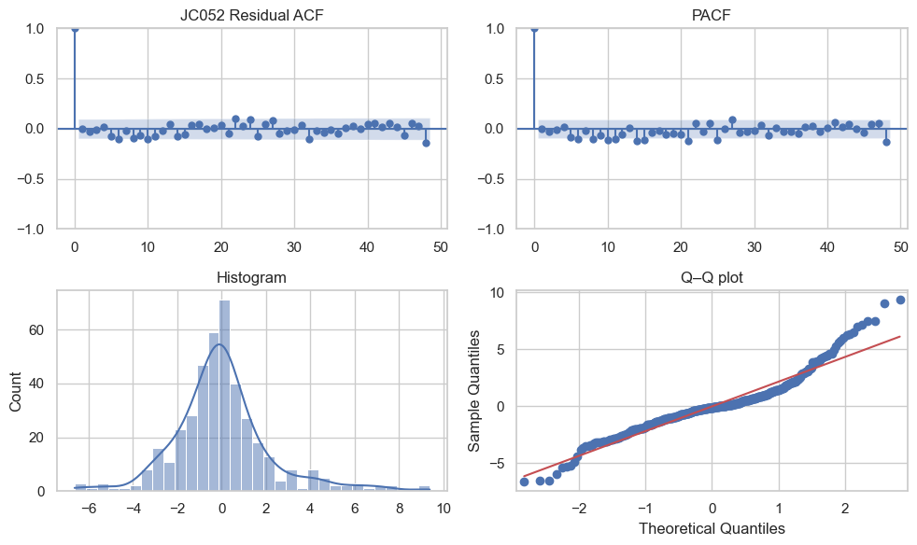
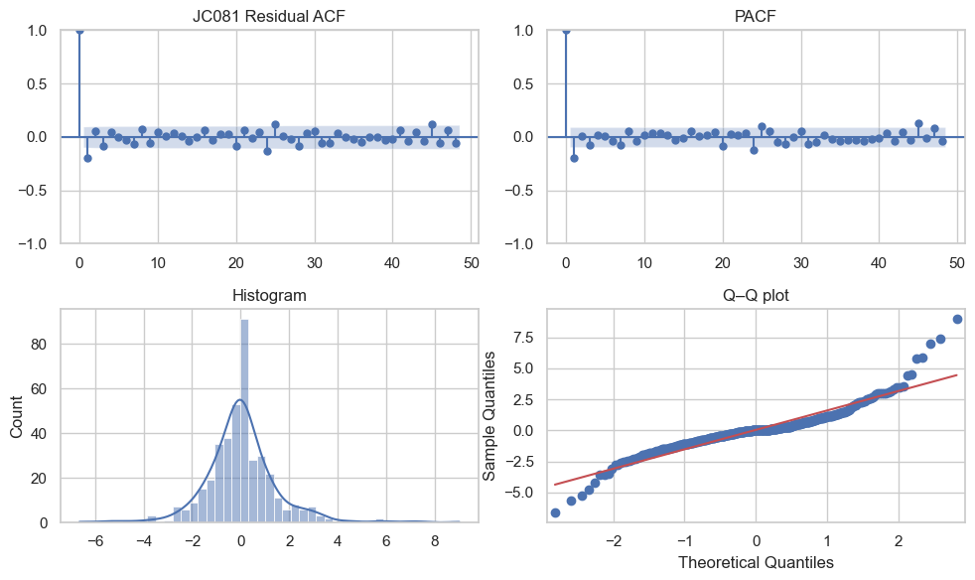
Model selection rationale
Key Analysis Points
JC052
1
ARMA, ARIMA, and SARIMA were all tested against each other
2
SARIMA was the preferred model in every scenario (1,1,1)(0,1,1)[24] for JC052 and (1,1,1)(1,1,1)[24] for JC081
3
The residual plots demonstrated that there is no major autocorrelation remaining with normally distributed residuals
4
SARIMA was the model that was selected to be used
JC081
Model Selection
Index | Station | Family | Order | AIC | BIC
0 | JC052 | SARIMA | (1,1,1)×(0,1,1)[24] | 1580.408162 | 1595.963674
1 | JC052 | SARIMA | (1,1,1)×(1,1,1)[24] | 1582.405864 | 1601.850254
2 | JC052 | SARIMA | (1,1,1)×(1,1,0)[24] | 1681.898879 | 1697.465456
3 | JC081 | SARIMA | (1,1,1)×(1,1,1)[24] | 1239.627859 | 1259.072249
4 | JC081 | SARIMA | (1,1,1)×(0,1,1)[24] | 1257.424234 | 1272.979745
5 | JC081 | SARIMA | (1,1,1)×(1,1,0)[24] | 1313.221552 | 1328.788129
A time covariate was tested to see if it would improve the tradition SARIMA model, however
it did not. The code can be found in the appendix section of the ipynb
Notes:
For model selection, we tested three families—ARMA, ARIMA, SARIMA—against each other.
In our analysis, SARIMA came out on top for both docks that can be seen in the table below, but with two different seasonal structures.
JC 081 needs both seasonal AR and MA terms to capture its sharper commuter peak; JC 052 only needs the seasonal MA, so it stays one parameter leaner.
Before moving forward with the SARIMA model, we looked at the residual plots shown on this slide and concluded that we see no major autocorrelation left and the histograms and Q-Q plots look close to normal
These graphs highlight that there is no under or over fitting. So that is why SARIMA was chosen as the best model to move forward with for our analysis.

Slide 8
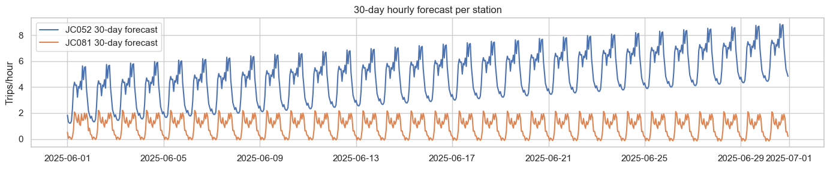
Forecasting results
Key Analysis Points
Implications
1
Steady growth: JC 052 dock shows a ~25 % upward trend across the 30-day horizon – summer demand ramp-up is beginning
1
Daily truck loop needed – pre-peak to ensure enough bikes at JC 052; late-evening pull from JC 081 to ensure no overflow of bikes
2
AM risk at JC 052: Weekday peaks hit 8 rides / h at 07 h; dock would empty in <2 h if un-serviced
2
Capacity alert – JC 052 will require +6 docks if peak > 8 rides / h persists beyond July
3
PM risk at JC 081: Arrivals push inventory toward full after 8pm, saturating the 13-dock site ~11 evenings
3
No docking stations at JC 081 and no bikes at JC 052 can cause customer loss meaning on average 4$ per customer per ride lost
4
Weekend divergence: Friday/Saturday increase is +35 % at JC 052 (out-flow) while +40 % inflow at JC 081 which makes them a great match
4
KPI monitoring – use RMSE-based 3-bike buffer to flag real-time inventory < 3 or > capacity–3 for automated dispatch
Notes:
The results we got highlighted the following:
First, dock JC 052 grows about 25 percent over the next month highlighting a summer ramp-up.
AM danger: JC 052 empties right after the 07 a.m. peak—8 rides an hour would clear 19 docks in about 2 hours
PM danger at JC 081: arrivals flood the 13-dock site after 8 p.m.; it’ll be full on eleven evenings
Friday/Saturday diverge: JC 052 loses bikes just when JC 081 gains them on the weekend which makes them a perfect match for switching bikes
So what does this imply for citybike?
CityBike will need a daily truck loop: early-morning drop at 052, late-night pull from 081
If that 8-ride peak holds for two weeks, JC 052 needs six more docks to ensure a high service level and availability
Empty at 081 or full at 052 costs us roughly four dollars per lost ride which can scale very fast in lost revenue
Inventory should be flagged outside a ±3-bike buffer, because that’s 95 percent of our prediction error

Slide 9

Citibike strategy based on forecasting results
Dynamic rebalancing loop
Capacity upgrade
Smart staffing & incentives
Daily 5 am drop-off 10 bikes at JC 052 to cover the 7 am commuter spike
Nightly 9 pm pick-up 8 bikes from JC 081 on Friday and Saturday to free docks and refill JC 052
Target inventory bands of 3 to capacity-3 for 95% service level
If JC 052 peak hits above 8 rides / hour for more than 2 weeks consider upgrading capacity
Ideally, JC 052 would need 6 new docks to comfortably handle those peaks reducing cost of restocking
Consider using valet attendants similar to JC115 from 6-8 am to ensure higher turnarounds
Use incentives like return credit after a specific hour from specific dock stations like JC 081 to direct riders to start from saturated docks
Notes:
Dynamic rebalancing loop
Daily, 5 a.m., we drop ten bikes at 052 which covers the 07 a.m. commuter spike.
Friday and Saturday at 9 p.m. we pull eight bikes from 081: frees docks there, tops up 052 for the morning.
We always aim to keep each dock between three bikes and capacity minus three.
Capacity upgrade
If 052 stays above eight rides an hour for two solid weeks, we install six additional docks
This can be done in phases by implementing a valet service ensuring 6 extra bikes are available and testing the service level at that rate to ensure no wasted bikes are installed.
Smart staffing & incentives
For extra safety we can apply a full time valet service from 6–8 a.m. at 052 just like JC115 to provide bikes faster.
Or we could provide an incentive to riders through return credit after or before certain hours to start or end at specific stations to make bike movement cheaper and less of a burden on citibike.
Conclusion
These three strategies can ensure a better rider experience in Jersey City and specifically for these two stations. In the longterm a more comprehensive analysis can be done to balance out more stations.

Slide 10
Thank You

